Slide 1

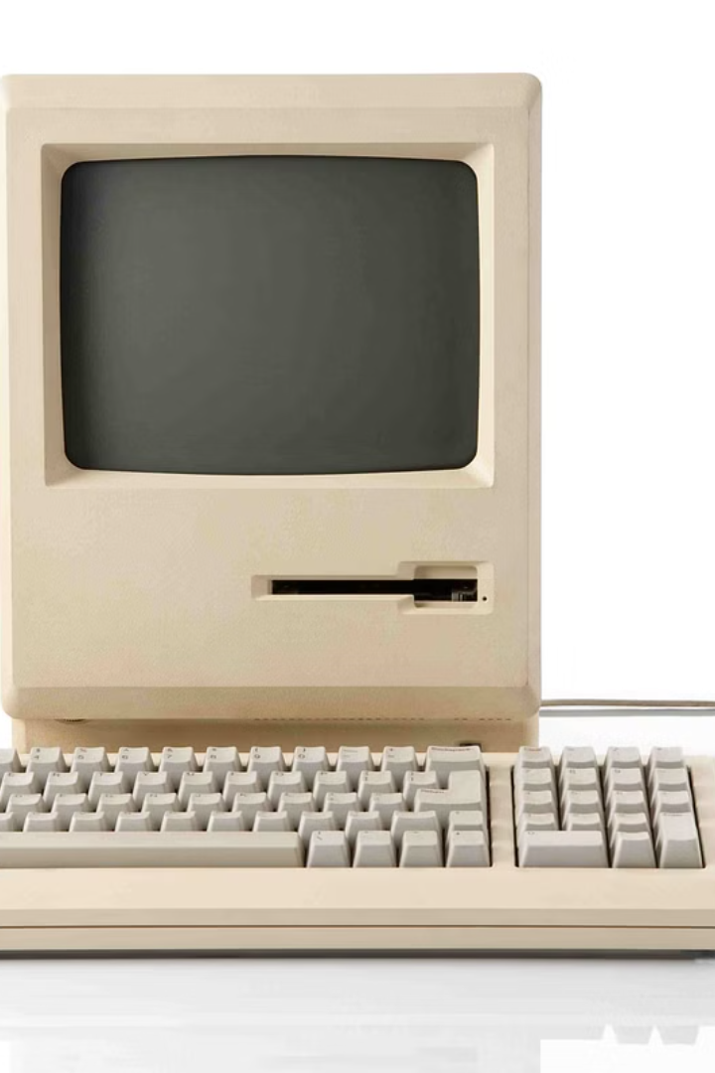

How does classical computers works
Classical computers work on the basis of binary code, using bits to represent information as either a 0 or a 1. These computers process information using logic gates, performing operations such as AND, OR, and NOT to manipulate and manipulate the binary data. The central processing unit (CPU) of a classical computer carries out these operations and coordinates the flow of data within the computer system.
The CPU is composed of several components, including the control unit, arithmetic logic unit (ALU), and registers. The control unit fetches instructions from memory and directs the operations of other components, while the ALU performs mathematical and logical operations. Registers store temporary data and control signals to facilitate efficient processing. Together, these components work harmoniously to execute instructions and perform tasks on a classical computer.

Slide 2
Basic Components and Operations
CPU
Memory
Input/Output
The central processing unit performs calculations and executes instructions.
Stores data and instructions for the CPU to access.
Devices to send and receive information, like keyboards and monitors.

Slide 3
Limitations and Challenges
1
Processing Speed
2
Memory Capacity
3
Energy Consumption
Classical computers have limitations related to processing speed.
Defining the amount of data and instructions a computer can store.
Addressing the energy consumption associated with classical computers.

